Slide 1

SENTIMENT ANALYSIS ON TWEETS
BY
AHSAN FAYYAZ
BIRTH SUBHASH
JUNAID ZIA KHAN

Slide 2
Purpose of Sentiment Analysis
To obtain opinions and views of people on a particular topic.
Used in the marketing industry to assess people’s views before movies come out.
Also used to gather opinions when campaigns for products are created.

Slide 3
Our two approaches
PYTHON
KNIME

Slide 4
Python approach

Slide 5
Our approach
We used the twitter api, tweepy to obtain a dataset that was filled with tweets.
We populated the database of tweets by running the main.py file.
Then we used the animate.py file to visually represent the tweets.

Slide 6
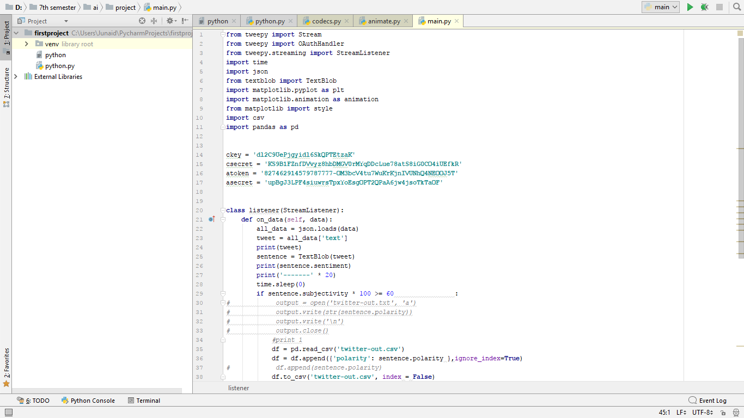
Main.py code

Slide 7
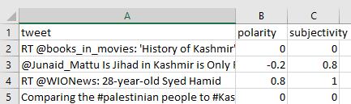
Database obtained by main.py

Slide 8
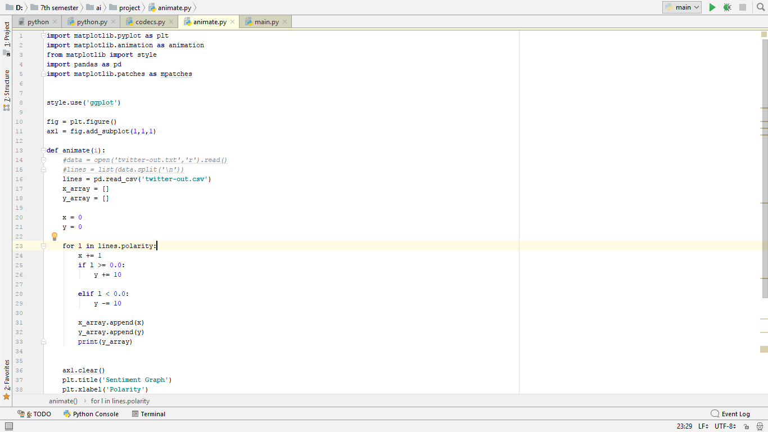
Animate.py

Slide 9
Knime approach

Slide 10
Our approach
We created one more column in the dataset, called rating. A 5-point scale was used to rate the sentiment of the tweets.
Further, we portioned the data into two equal sets, the training set and a test set.
We then created a workflow on knime.
And we used a tag cloud to visually represent the tweets.
As well as a naïve bayes predictor to predict results for the test data set.

Slide 11
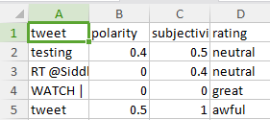
Adding the rating column to the mix

Slide 12
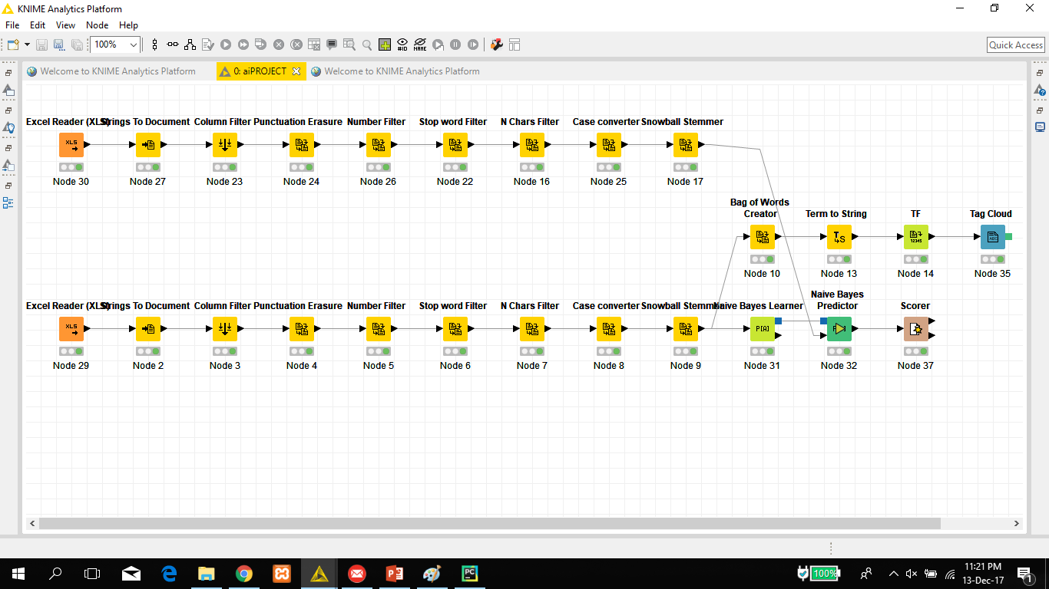
Our entire workflow

Slide 13
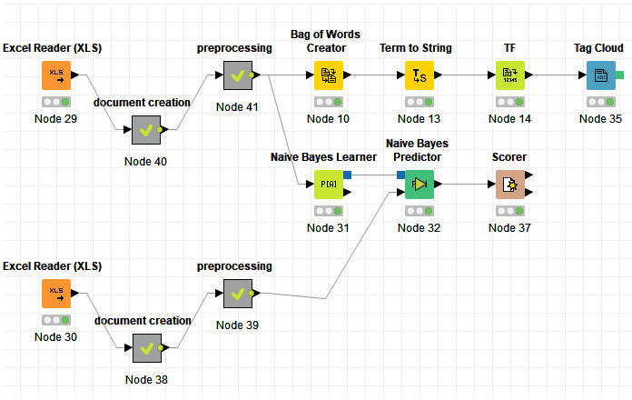
Workflow with compressed metanodes

Slide 14
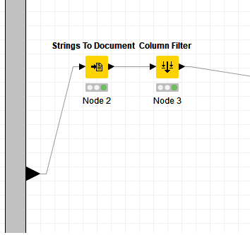
Document creation

Slide 15
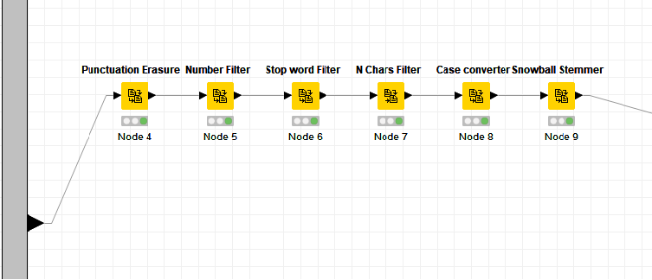
Preprocessing metanode

Slide 16
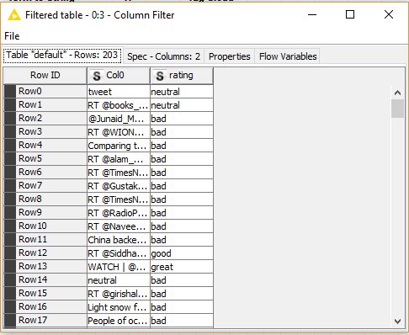
Results from naïve bayes predictor

Slide 17
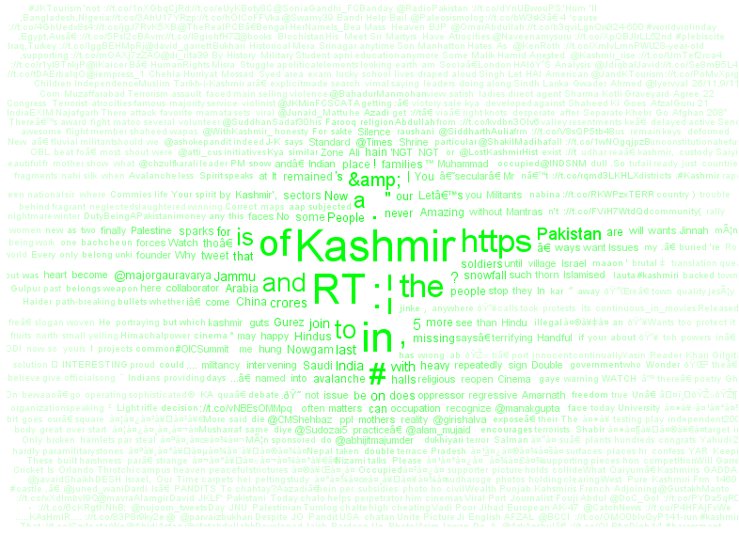
Tag cloud

Slide 18
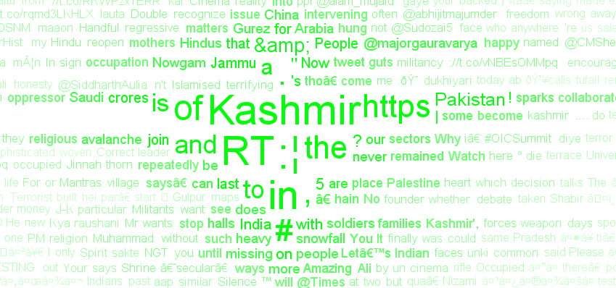
Zoomed in

